Slide 1
Deep Deterministic policy gradient
Optimal execution of portfolio Transaction

Slide 2

Outline
Almgren and chirss model
Input: $a_{t}$
Output: $S_{t} , r_{t} , S_{t+1}$
DDPG
DQN + DPG

Slide 3
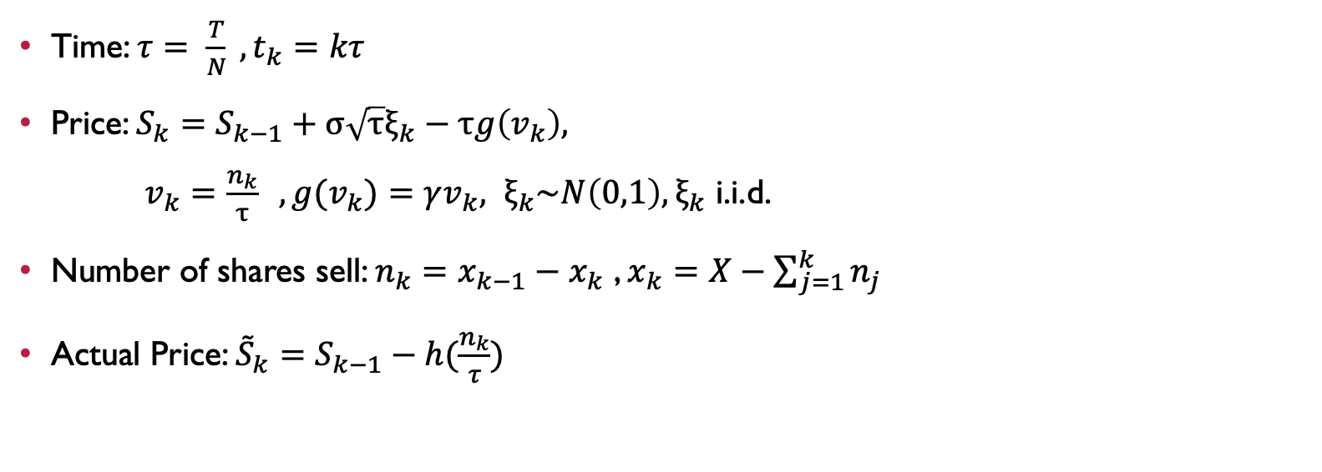
Almgren and Chriss model
Time: $τ= \frac{T}{N} , t_{k}=kτ$
Price: $S_{k}=S_{k−1}+σ\sqrt{τ}ξ_{k}−τg\left(v_{k}\right),$
$v_{k}=\frac{n_{k}}{τ} ,g(v_{k})=γv_{k}, ξ_{k}\sim N\left(0,1\right),ξ_{k}$ i.i.d.
Number of shares sell: $n_{k}=x_{k−1}−x_{k}$ , $x_{k}=X−\sum_{j=1}^{k}{n_{j}}$
Actual Price: ${\tilde{S}}_{k}=S_{k−1}−h(\frac{n_{k}}{τ})$

Slide 4
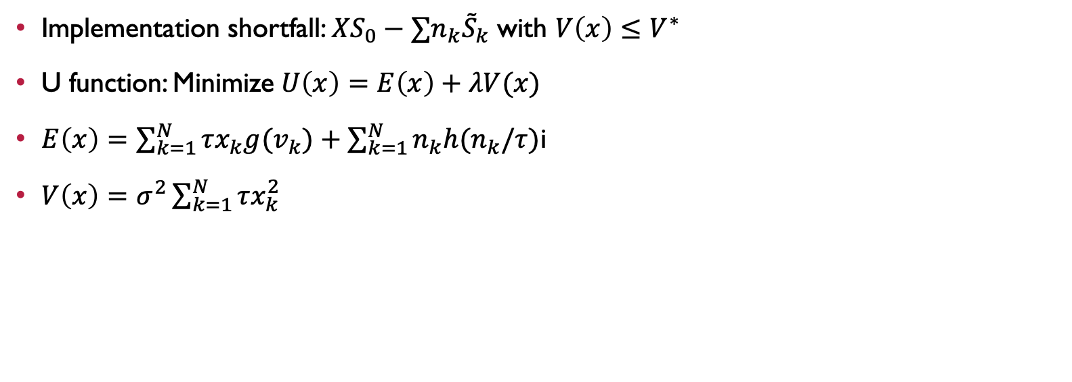
Almgren and Chriss model
Implementation shortfall: $XS_{0}−∑n_{k}{\tilde{S}}_{k}$ with $V\left(x\right)≤V^{∗}$
U function: Minimize$U\left(x\right)=E\left(x\right)+λV(x)$
$E\left(x\right)=\sum_{k=1}^{N}{τx_{k}g(v_{k})}+\sum_{k=1}^{N}{n_{k}h(n_{k}/τ)}$i
$V\left(x\right)=σ^{2}\sum_{k=1}^{N}{τx_{k}^{2}}$

Slide 5
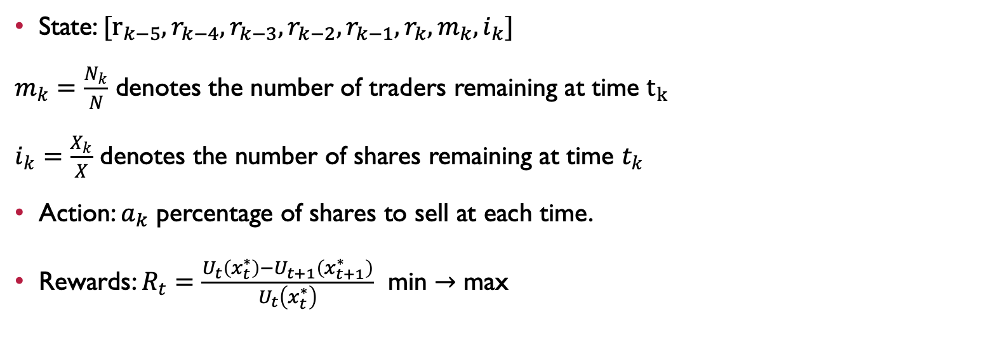
MODEL
State: $[r_{k−5},r_{k−4},r_{k−3},r_{k−2},r_{k−1},r_{k},m_{k},i_{k}]$
$m_{k}=\frac{N_{k}}{N}$ denotes the number of traders remaining at time $t_{k}$
$i_{k}=\frac{X_{k}}{X}$ denotes the number of shares remaining at time $t_{k}$
Action: $a_{k}$ percentage of shares to sell at each time.
Rewards: $R_{t}=\frac{U_{t}\left(x_{t}^{∗}\right)−U_{t+1}\left(x_{t+1}^{∗}\right)}{U_{t}\left(x_{t}^{∗}\right)}$ min $→$ max

Slide 6
DDPG
Algorithm | Action Space | Policy Space
Q-learning | Discrete | Discrete
DQN | Discrete | Continuous
DDPG | Continuous | Continuous
Actor-critic algorithm
Actor: decides which action to take
Critic: tells the actor how good its action was and how it should adjust

Slide 7
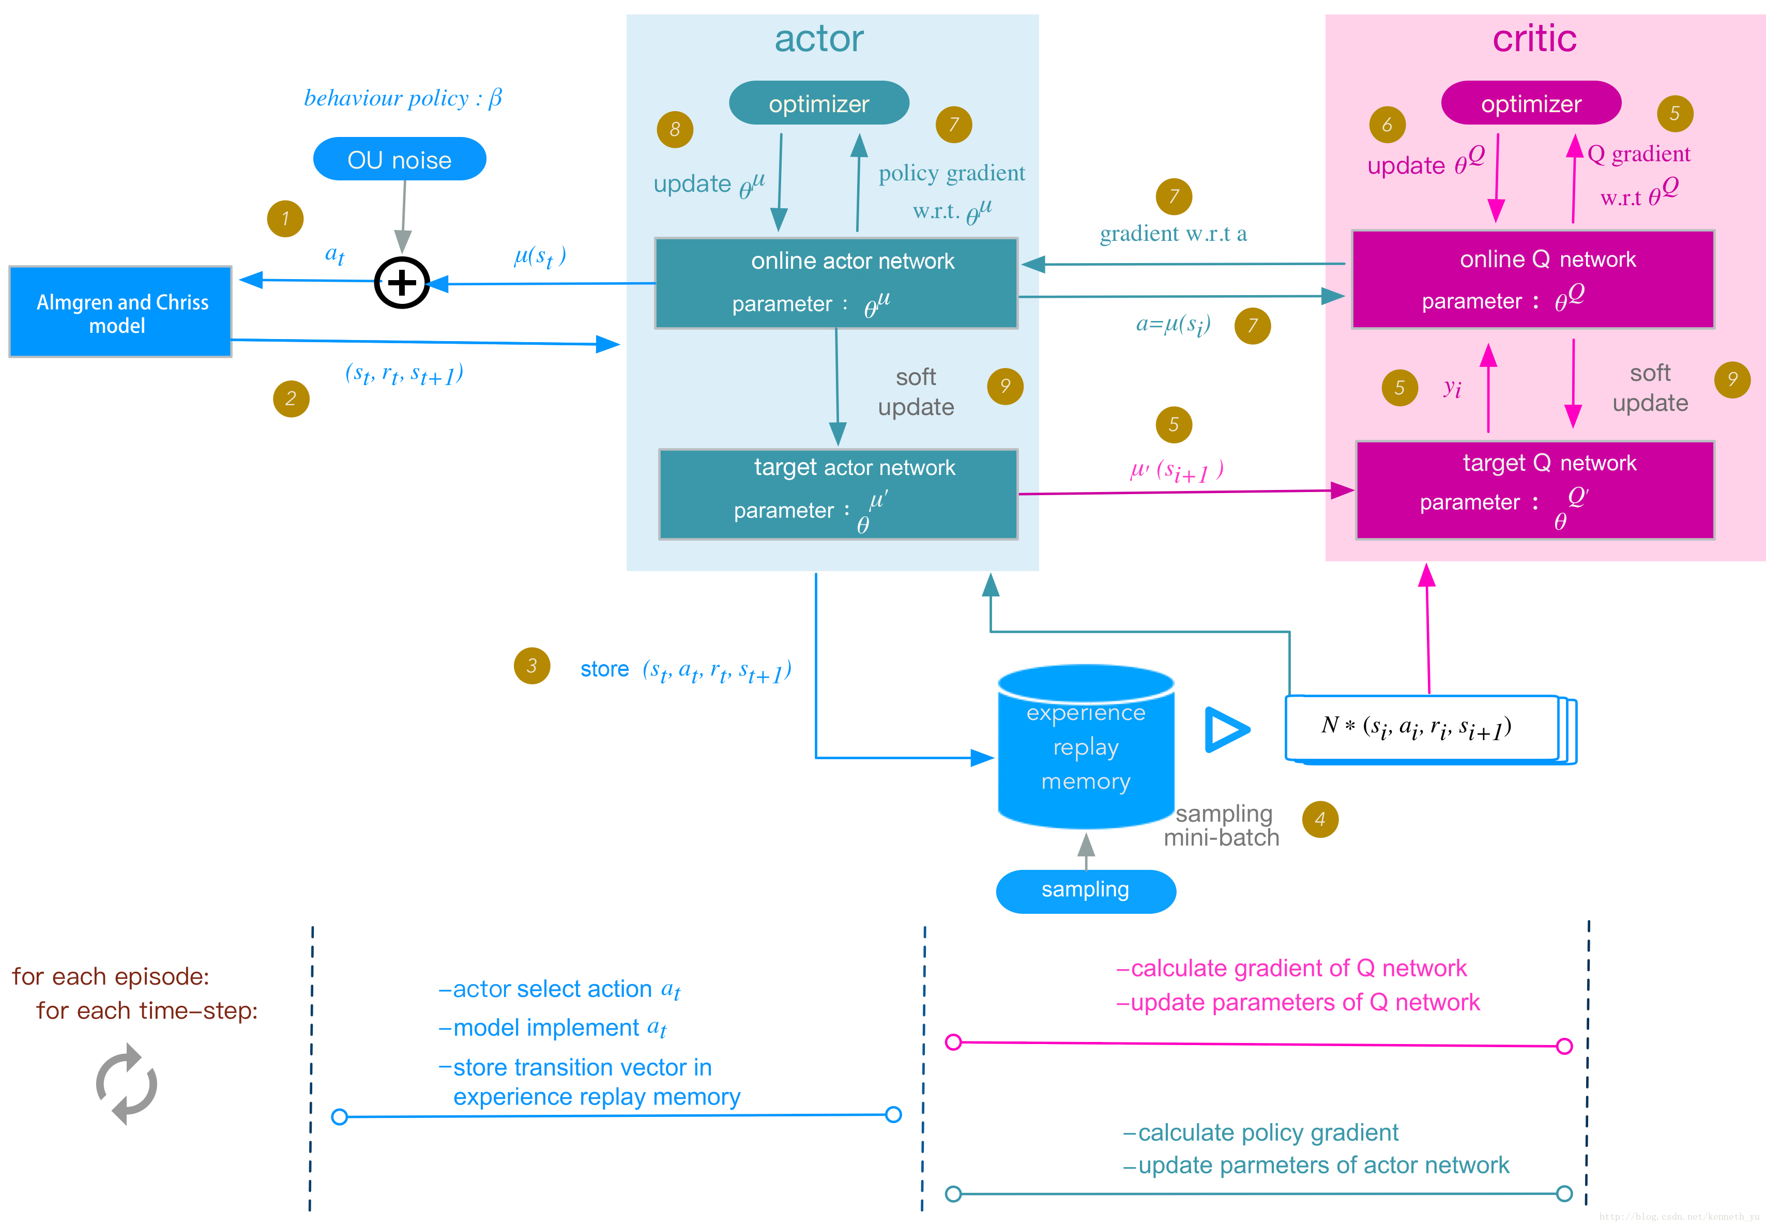

Slide 8
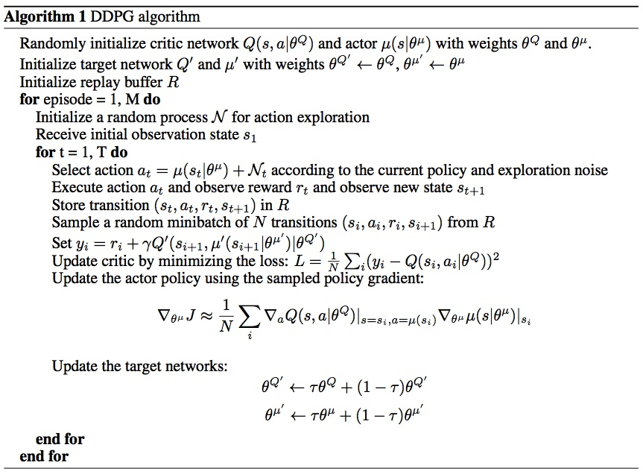

Slide 9
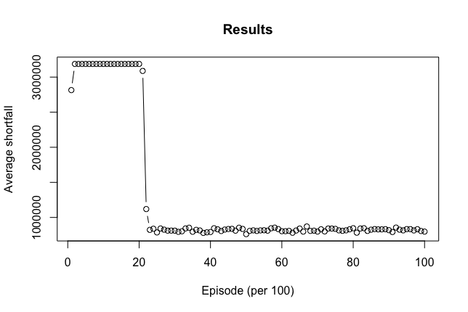
Parameters and results
Annual Volatility | 10%
Bid-Ask Spread | 0.125
Daily Volatility | 0.6%
Daily Trading volume | 4,000,000
Total number of shares to sell | 1,000,000
Stock price per share | 30
Trader’s risk aversion | 1e-05
Number of days to sell all shares | 2 months (60 days)
Number of Trades | 60

Slide 10
